Slide 1

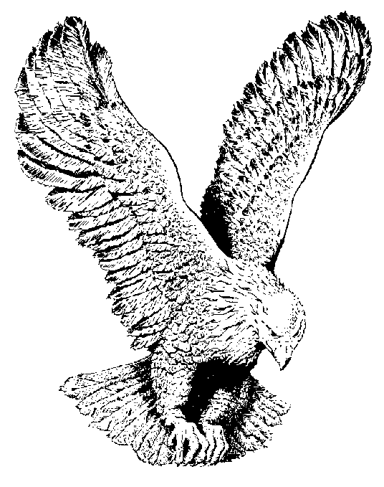
814 FEAR NOT
When you sit at a well set table with your plates without a bite
Recall, He did, two fishes and five loaves,
Five thousand hungry that day feed.

Slide 2
CHORUS
Jesus is not too far away,
He is right here, so very near
He sees the problems that you face,
“Peace be still!”, He speaks His Word.

Slide 3
When your child on the sick bed lay
And the doctor with his head a shaking
Recall, He, the Spoken Word say,
The sick got well and the dead raised to life.

Slide 4
Sister Meda with a tumour a struck
And on his knees our prophet did go
Recall, the Word by the Lord’s command
He spoke, the tumour dissolved.

Slide 5
Hattie Wright, with the right attitude
Received a visit from the prophet of the Lord
Recall, she said, “that’s the truth, Brother Bill”
And her way-ward sons received eternal life.

